Slide 1





Annual Interagency Accessibility Forum
Beyond Compliance: Building a Culture of Digital Accessibility
November 7-9, 2023
Section 508 Common Issues for Documents
November 7, 2023

Slide 2



Presenters
Brooke Aiken​
Moderator
Alfred Vallarta​
Presenter
Matthew Greener
Presenter
Brooke Aiken
FDIC Section 508 Program Manager
Alfred Vallarta
FDIC Section 508 Specialist
Matthew Greener
FDIC Section 508 Specialist

Slide 3

Agenda
Common Accessibility Issues for all types of Documents
Common Accessibility Issues for Word Documents
Common Accessibility Issues for PDF Documents
Common Accessibility Issues for PPT Documents

Slide 4

What is Section 508?
Agencies must provide employees with disabilities and members of the public access to information that is comparable to the access available to others.
Enacted to eliminate barriers in IT, to make available new opportunities for people with disabilities, and to encourage development of technologies that will help achieve these goals.
Applies to all Federal agencies when they develop, procure, maintain, or use ICT
Enforceable as of June 21, 2001
New Standards effective January 18, 2018

Slide 5
Common Accessibility issues for all types of Documents (Word, PDF, PPT)
Make sure Alt Text is descriptive enough and double check that all images have the correct Alt Text.
Hyperlinks should be descriptive. Avoid using “click here” and “read more” in the Text to Display field.
Any content in the headers, footers, and in watermarks should be duplicated in the document body because this information is hidden to assistive technology.
Ensure the color contrast between text and background is sufficient. All text should pass this check using the Color Contrast Analyzer tool.
Colors and other visual characteristics that convey information should also be described in text.
Double check that the Document Properties are filled out.
Remember to use dashes in the file name in place of blank spaces or underscores.

Slide 6
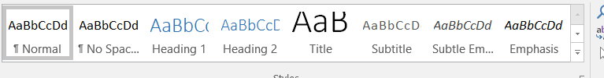
Common Accessibility issues for Word Documents (1 of 4)
Headings are not properly set – Only use one Heading 1
Use proper hierarchy, ie. Heading 2 goes after Heading 1
Always use Heading 1 instead of the Title style

Slide 7
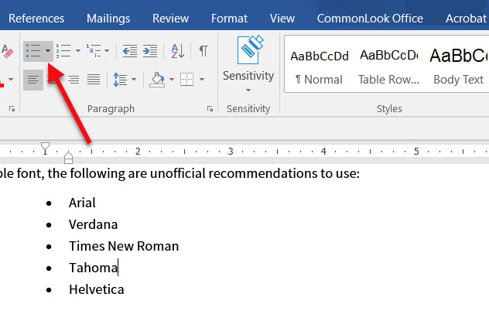
Common Accessibility issues for Word Documents (2 of 4)
Lists are not properly set – Use the built-in list features to ensure lists are available to assistive technology.

Slide 8
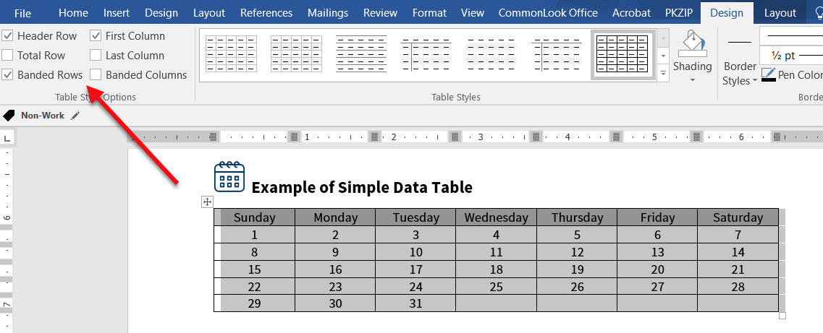
Common Accessibility issues for Word Documents (3 of 4)
To ensure that assistive technology recognizes the table headings and data cells – Select the Table Style Options to set the Header Row, Columns and/or Banded Rows/Columns.

Slide 9
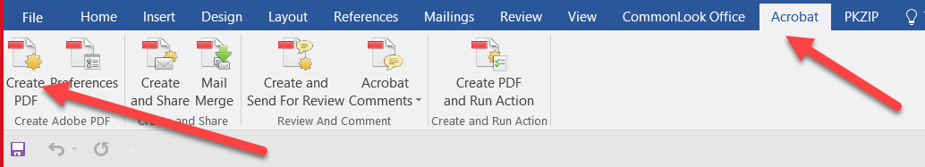
Common Accessibility issues for Word Documents (4 of 4)
When converting the document to a PDF, make sure that you use Create PDF button from the Acrobat tab. Do NOT create a PDF from File > Save as PDF.

Slide 10
Common Accessibility issues for PDF Documents
Make sure that the reading order displayed in the Tags panel coincides with the logical reading order of the document.
It is necessary that all headings in a PDF have a heading style (H1, H2, H3) .
Table structures should have Table Headers and Table Data tags.
Use the Reading Order Pane to tag untagged items and change tags.

Slide 11
Common Accessibility issues for PowerPoint Documents
Add Missing Titles, from the Layout option, for slides – The missing titles were either deleted or the master slide template was not used.
Use the Selection Pane to set the Reading Order – Every slide should match the visual layout in the Selection Pane. A screen reader reads the Selection Pane from the bottom up.

Slide 12
Common Accessibility issues for a Screen Reader User
Links not being descriptive
Proper description within Alt Text
Headings within the document structure
4. Table titles should be added to the alt text in the Table Properties

Slide 13

Questions?

